Slide 1
MSLU in the Programme “Erasmus Plus”

Slide 2
MSLU in the Programme “Erasmus Plus”
“Erasmus Plus” is the EU Programme in the fields of education, training, youth, and sport for the period 2014-2020. Education, training, youth, and sport can make a major contribution to help tackle socio-economic changes, the key challenges that Europe will be facing until the end of the decade and to support the implementation of the Europe 2020 strategy for growth, jobs, social equity and inclusion

Slide 3
Moscow State Linguistic University (MSLU) takes part in the key actions “Learning Mobility of Individuals” and “Mobility of Learners and Staff” of Programme “Higher education student and staff mobility between Programme and Partner Countries”
MSLU signed the Inter-institutional agreements with a number of Universities of Spain, France and Bulgaria (2016/mid.2017)

Slide 4
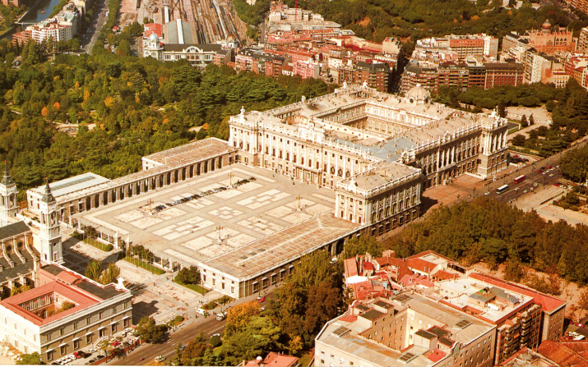
The selection of candidates is carried out on a competitive basis at the level of faculties and institutions of the university

Slide 5
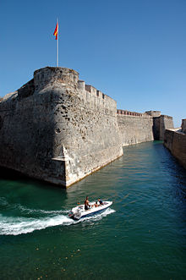
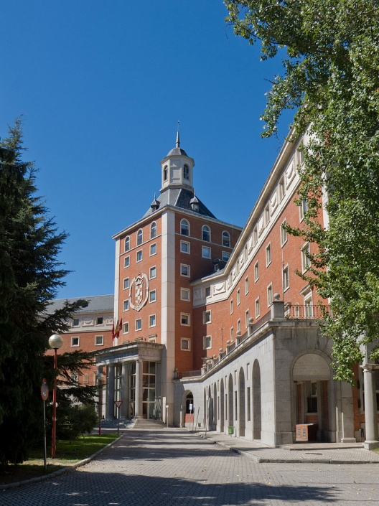
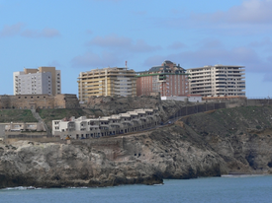
University of Granada, Spain

Slide 6
University of Granada, Spain
 | Total |  |  |  | Total number of months of the study periods |  |  |  | Recommended language of instruction level
 | Undergraduate | Master | Postgraduate | Staff | Undergraduate | Master | Postgraduate | Staff | Undergraduate/ Postgraduate | Staff
MSLU | 2 | 0 | 1 | 1 | 5 months | 0 | 5 months | 5 days | B2 | B2
University of Granada | 2 | 0 | 1 | 2 | 5 months | 0 | 6 months | 5 days | B1 | B2
MSLU → University of Granada:
Implemented mobility 2016: – 2 undergraduates
– 1 postgraduate
Selected candidates 2016/2017: - 1 staff

Slide 7
Complutense University of Madrid, Spain

Slide 8
Complutense University of Madrid, Spain
 | Total |  |  | Total number of months of the study periods |  |  | Recommended language of instruction level
 | Undergraduate | Postgraduate | Staff | Undergraduate | Postgraduate | Staff | Undergraduate /Postgraduate | Staff
MSLU | 3 | 0 | 1 | 5 months | 0 | 7 days | B1 | B2
Complutense University of Madrid | 1 | 2 | 1 | 5 months | 3 months | 7 days | B2-C1 | B2
MSLU → Complutense
Implemented mobility 2016: – 3 undergraduates
Selected candidates 2016/2017: - 1 staff
Complutense → MSLU
Implemented mobility 2016: - 1 staff
Selected candidates 2016/2017: - 1 undergraduate
- 1 postgraduate

Slide 9
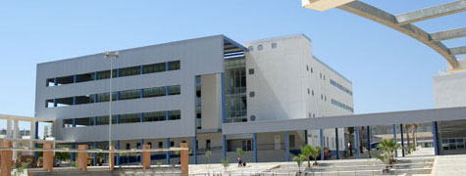
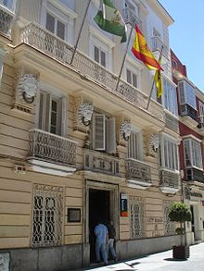
University of Cadiz, Spain

Slide 10
University of Cadiz, Spain
 | Total |  |  | Total number of months of the study periods |  |  | Recommended language of instruction level
 | Master | Postgraduate | Staff | Master | Postgraduate | Staff | Master/ Postgraduate | Staff
MSLU | 4/3 | 4 | 1 | 5 months | 5 months | 5 days | B2 | B2
University of Cadiz | 2 | 2 | 1 | 5 months | 5 months | 5 days | B1 | B2
MSLU → Cadiz
Implemented mobility 2016: – 4 masters
Selected candidates 2016/2017: - 1 staff
Cadiz → MSLU
Selected candidates 2016/2017: - 1 staff

Slide 11
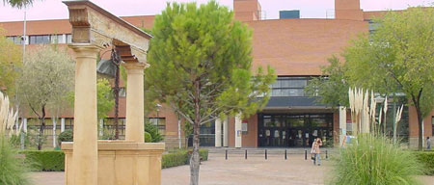
University of Castilla-La Mancha, Spain

Slide 12
University of Castilla-La Mancha, Spain
 | Total |  | Total number of months of the study periods |  | Recommended language of instruction level
 | Undergraduate | Staff for teaching | Undergraduate | Staff for teaching | Undergraduate | Staff for teaching
MSLU | 1 | 1 | 5 months | 5 days | B1 | B2
University Castilla-La Mancha | 1 | 0 | 5 months | 0 | B1 | B2
MSLU → Castilla-La Mancha
Selected candidates 2016/2017: – 1 undergraduate
- 1 staff

Slide 13
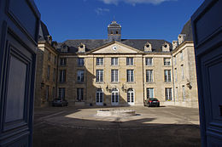
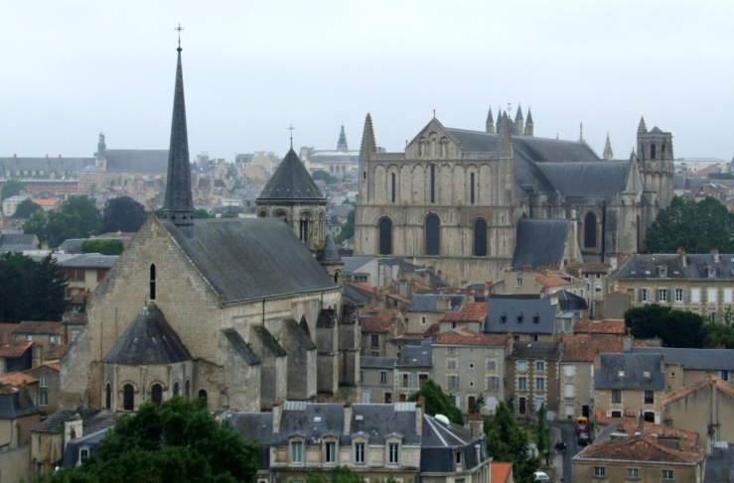
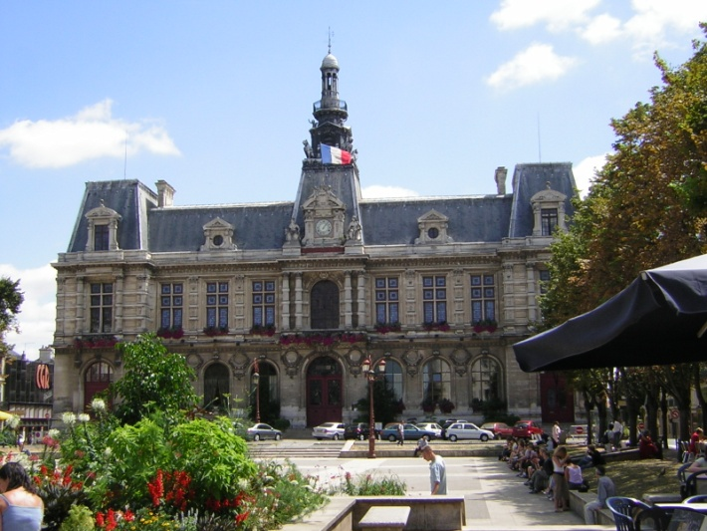
University of Poitiers, France

Slide 14
University of Poitiers, France
 | Total |  |  |  |  | Total number of months of the study periods |  |  |  | Recommended language of instruction level
 | Undergraduate | Master | Postgraduate | Staff for teaching | Staff for training | Undergraduate | Master | Postgraduate | Staff for teaching/ training | Undergraduate/ Postgraduate | Staff for teaching/ training
MSLU | 2 | 2 | 1 | 2 | 1 | 5 months | 5 months | 6 months | 13 days | B2 | B2
University of Poitiers | 2 | 1 | 1 | 1 | 1 | 5 months | 5 months | 6 months | 13 days | B2 | B2
MSLU → Poitiers
Selected candidates 2016/2017: – 2 undergraduates
- 2 masters
– 1 postgraduate
- 3 staff

Slide 15
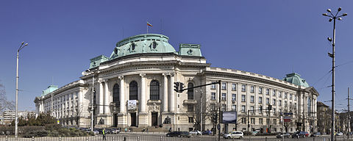
New Bulgarian University, Sofia, Bulgaria

Slide 16
New Bulgarian University, Sofia, Bulgaria
 | Total |  | Total number of months of the study periods |  | Recommended language of instruction level
 | Undergraduate | Staff for teaching | Undergraduate | Staff for teaching | Undergraduate | Staff for teaching
MSLU | 3 | 1 | 5 months | 7 days | B1 | B2
New Bulgarian University | 0 | 0 | 0 | 0 | B1 | B2
MSLU → NBU
Selected candidates 2016/2017: – 3 undergraduates

